Slide 1
Week 5 Array and Vector part 2
CS 331
An introduction to C++ and Object-Oriented Programming
MD Romael Haque

Slide 2
Partially Filled Arrays
Sometimes you need to store a series of items in an array, but you do not know the exact number of items.
As a result, you do not know the number of elements needed for the array.
One solution is to make the array large enough to hold the largest possible number of items.
However, if the actual number of items stored in the array is less than the number of elements, the array will be only partially filled.
When you process a partially filled array, you must only process the elements that contain valid data.

Slide 3

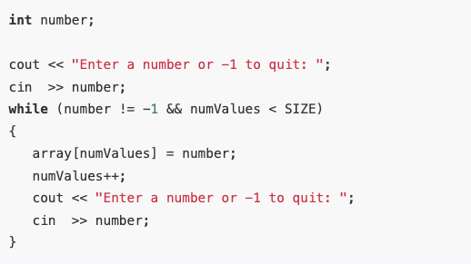
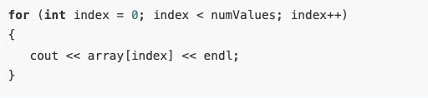
Partially Filled Arrays
To display all the valid values of an array

Slide 4
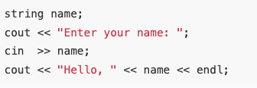
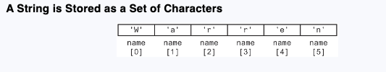

Processing Strings
Strings are internally stored as arrays of characters.
They are different from other arrays in that the elements can either be treated as a set of individual characters or can be used as a single entity.

Slide 5
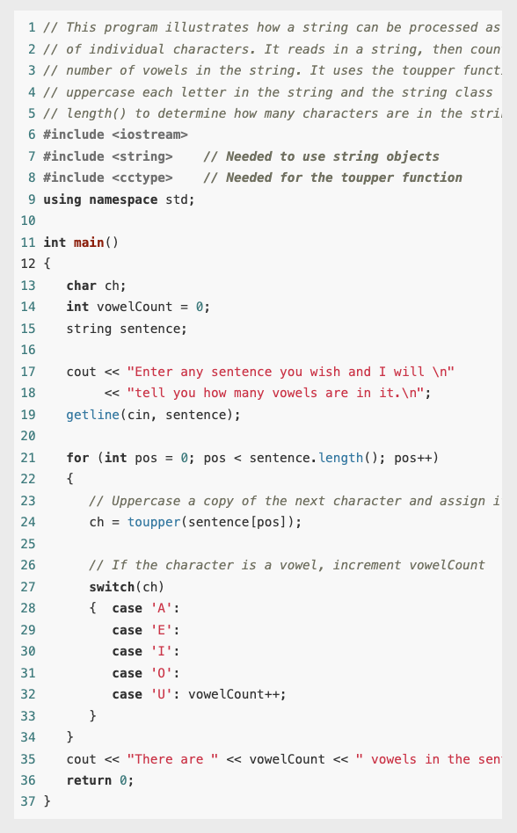
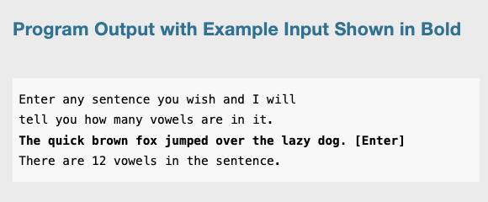
Example

Slide 6
Using Parallel Arrays
By using the same subscript, you can build relationships between data stored in two or more arrays.
Sometimes it is useful to store related data in multiple arrays, especially when the data consists of different types.
One array might hold one kind of information, while another stores corresponding details. These arrays can be linked through their indexes, so that elements with the same index in different arrays are related.
For instance, one array could store names, while another array holds values associated with those names, allowing the corresponding data to be easily accessed and used together.

Slide 7
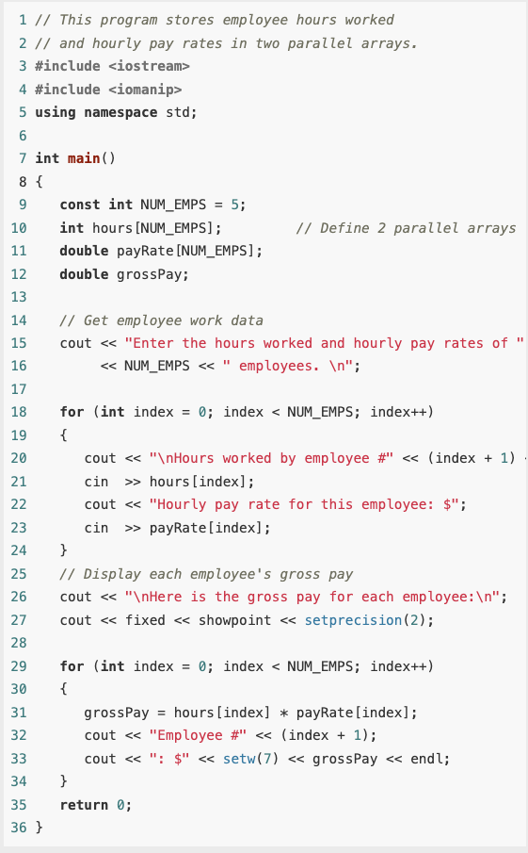
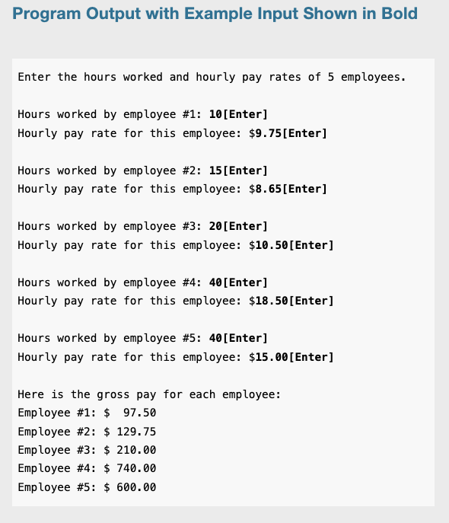
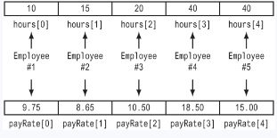
Example

Slide 8

The typedef Statement
The typedef statement allows an alias to be associated with a simple or structured data type.
The typedef statement allows the programmer to create an alias, or synonym, for an existing data type. This can be a simple data type, such as an int, or a more complicated data type, such as an array. The simplest form of the statement is –
typedef <existing data type> <alias>;

Slide 9
Arrays as Function Arguments
Individual elements of arrays and entire arrays can both be passed as arguments to functions
When a single element of an array is passed to a function, it is handled like any other variable.
Often it is simpler to pass an entire array to a function so only one function call is needed for the function to access all the elements.
When we pass an array to a function, we pass the name of the array. This means we are actually sending it the address of the array so it can access the elements.
Because the name of an array without a subscript does not hold any data at all. Instead it holds the starting address of where the array is located in memory. )

Slide 10
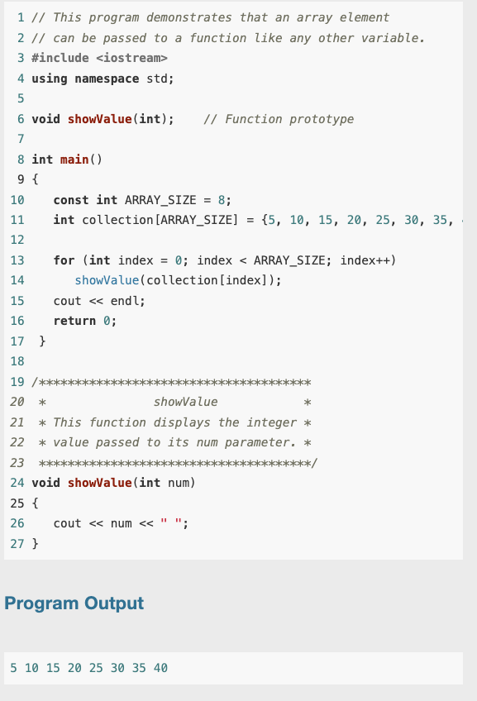
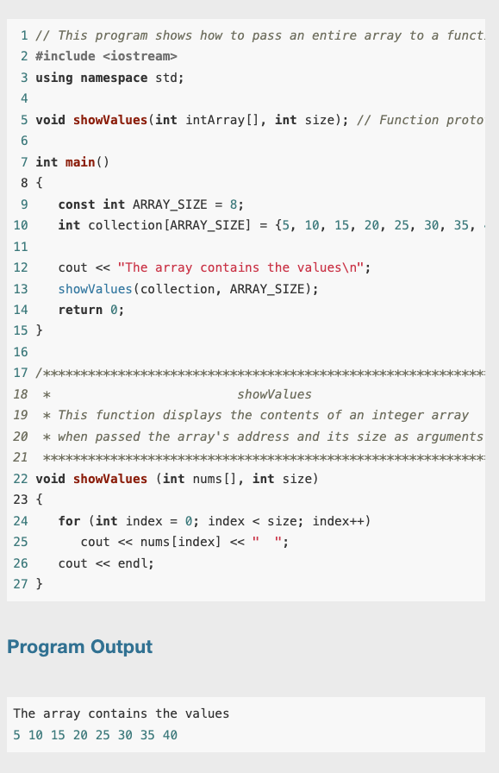
Arrays as Function Arguments

Slide 11
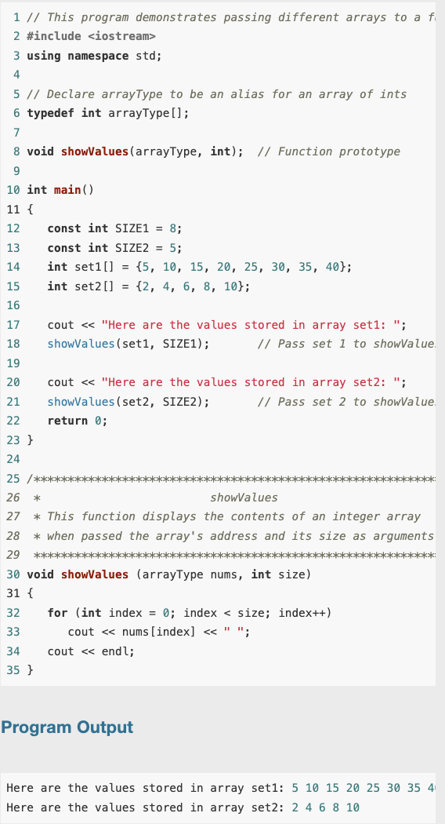
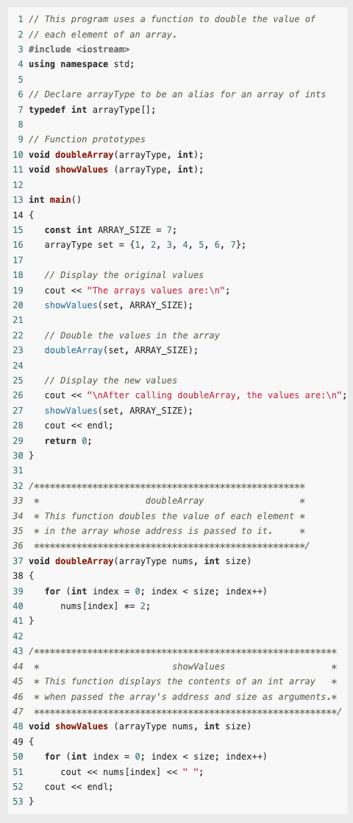
Example

Slide 12
Using const Array Parameters
Sometimes you want a function to be able to modify the contents of an array that is passed to it as an argument, but other times you don’t
You can prevent a function that should not change an array passed to it from accidentally making changes to it by using the const key word.

Slide 13
Two-Dimensional Arrays
A two-dimensional array is like several identical arrays put together. It is useful for storing multiple sets of data.
An array is useful for storing and working with a set of data. Sometimes, though, it’s necessary to work with multiple sets of data.
For example, in a grade-averaging program a teacher might record all of one student’s test scores in an array of doubles. If the teacher has 30 students, that means 30 arrays of doubles will be needed to record the scores for the entire class. Instead of defining 30 individual arrays, however, it would be better to define a two-dimensional array.

Slide 14
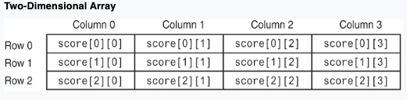
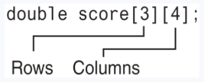
Two-Dimensional Arrays
It’s best to think of a two-dimensional array as a table having rows and columns of elements
To define a two-dimensional array, two size declarators are required. The first one is for the number of rows, and the second one is for the number of columns.

Slide 15
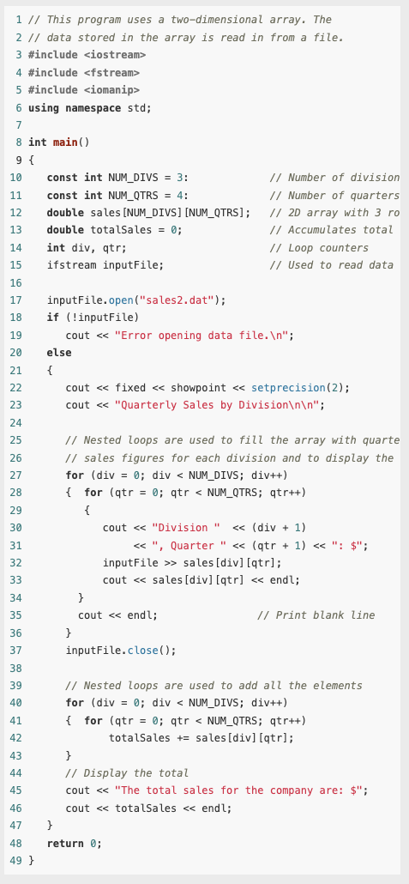
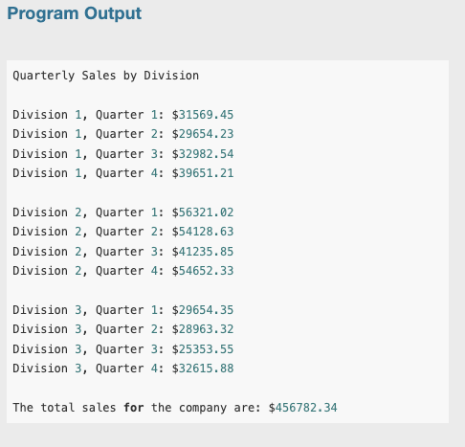
Example

Slide 16
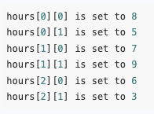

2-D Array initialization
int hours[3][2] = {{8, 5}, {7, 9}, {6, 3}};
OR
int hours[3][2] = {{8, 5}, {7, 9},
{6, 3}};
Same but extra braces is a good idea

Slide 17
Passing Two-Dimensional Arrays to Functions
When a two-dimensional array is passed to a function, the parameter type must contain a size declarator for the number of columns.
void showArray(const int array[][NUM_COLS], int numRows)

Slide 18
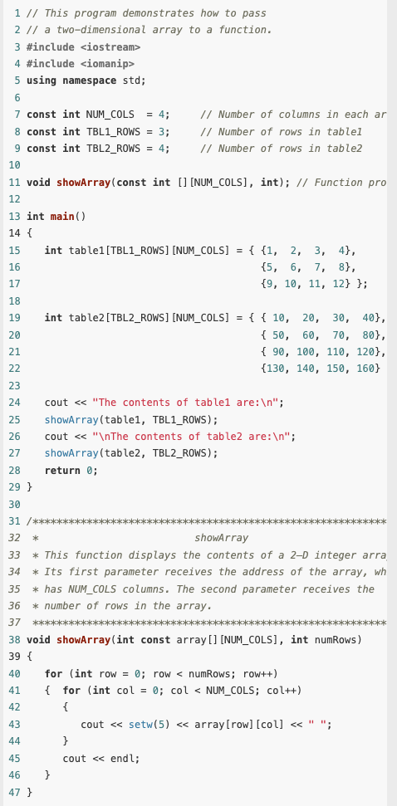
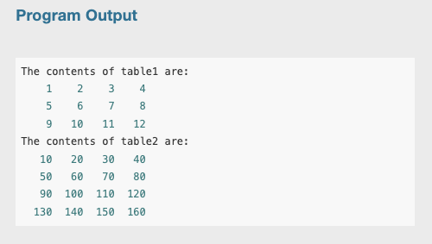
Example

Slide 19

Summing All the Elements of a Two-Dimensional Array
We summed all the data in a two-dimensional array by using a nested loop and adding the contents of each array element to an accumulator.

Slide 20
Summing the Rows of a Two-Dimensional Array
Sometimes, however, you need to calculate separately the sum of each row in a two-dimensional array.
You can again use the nested loops but now, after each summarization of a row you set the accumulator to zero

Slide 21
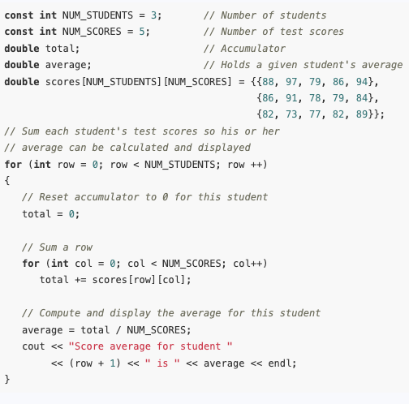
Summing the Rows of a Two-Dimensional Array

Slide 22
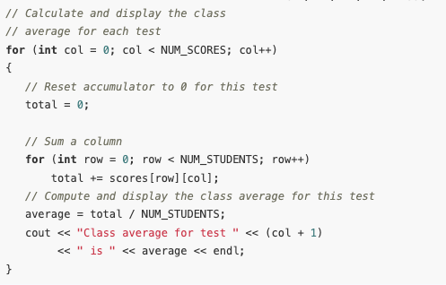
Summing the Columns of a Two-Dimensional Array
Same strategies as rows but the order of the two loops is reversed.

Slide 23
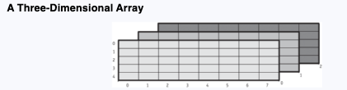
Arrays with Three or More Dimensions
C++ allows you to create arrays with virtually any number of dimensions. Here is an example of a three-dimensional (3D) array definition:
double seat[3][5][8];

Slide 24
Introduction to the STL vector
The Standard Template Library includes a data type called a vector.
It is similar to a one-dimensional array but has a number of advantages compared to a standard array.
To use vectors, your program header must indicate that you are using namespace std, since vectors are contained within that namespace.

Slide 25
Introduction to the STL vector
The data types that are defined in the STL are commonly called containers. They are called containers because they store and organize data.
There are two types of containers in the STL: sequence containers and associative containers.
A sequence container organizes data in a sequential fashion, similar to an array.
Associative containers organize data with keys, which allow rapid, random access to elements stored in the container.

Slide 26
A vector offers several advantages over arrays. Here are just a few:
You do not have to declare the number of elements that the vector will have.
If you add a value to a vector that is already full, the vector will automatically increase its size to accommodate the new value.
Vectors can report the number of elements they contain.

Slide 27
Defining and Initializing a Vector
#include <vector>
To create a vector object you use a statement whose syntax is somewhat different from the syntax used in defining a regular variable or array. Here is an example:
#vector<int> numbers;
No need to declare the size, but you can do it anyway
#vector<int> numbers(10);
This statement defines numbers as a vector of 10 ints, but this is only a starting size. Its size will expand if you add more than 10 values to it.

Slide 28
Defining and Initializing a Vector
When you specify a starting size for a vector, you may also specify an initialization value. The initialization value is copied to each element. Here is an example:
vector<int> numbers(10, 2);
You may also initialize a vector with the values in another vector. For example, if set1 is a vector of ints that already has values in it, the following statement will create a new vector, named set2, which is an exact copy of set1.
vector<int> set2(set1);
Or initialize a vector with a list of values
vector<int> numbers { 10, 20, 30, 40 };

Slide 29
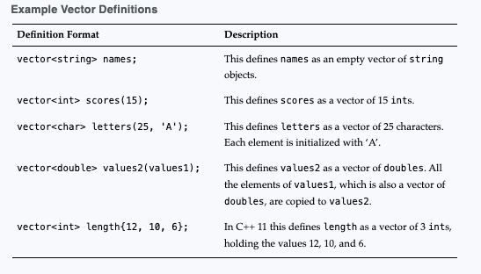
Defining and Initializing a Vector

Slide 30
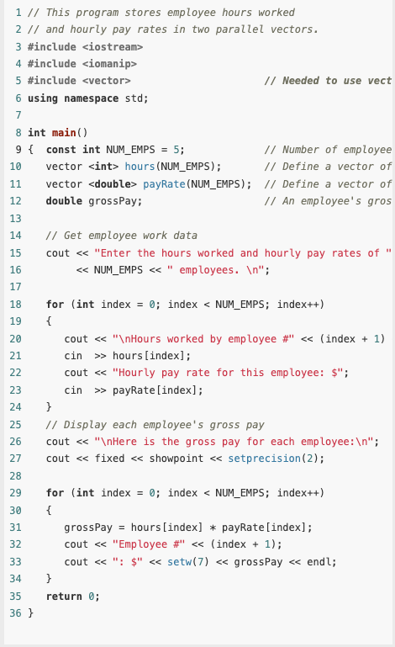
Example

Slide 31
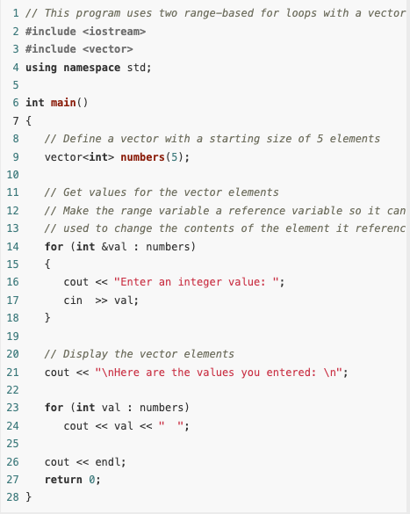
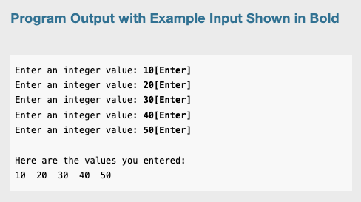
Example: Using the Range-Based for Loop with a vector

Slide 32
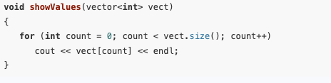
Determining the Size of a Vector
Unlike arrays, vectors can report the number of elements they contain. This is accomplished with the size member function. Here is an example of a statement that uses the size member function:
numValues = set.size();

Slide 33
Adding Elements to a vector
You cannot, however, use the [] operator to access a vector element that does not yet exist.
To store a value in a vector that does not have a starting size, or that is already full, you should use the push_back member function.
This function accepts a value as an argument and stores it in a new element placed at the end of the vector. (It “pushes” the value at the “back” of the vector.)
numbers.push_back(25);
This statement creates a new element holding 25 and places it at the end of numbers. If numbers previously had no elements, the new element becomes its single element.

Slide 34
Removing Elements from a Vector
To remove the last element from a vector you can use the pop_back member function. The following statement removes the last element from a vector named collection.
collection.pop_back();

Slide 35
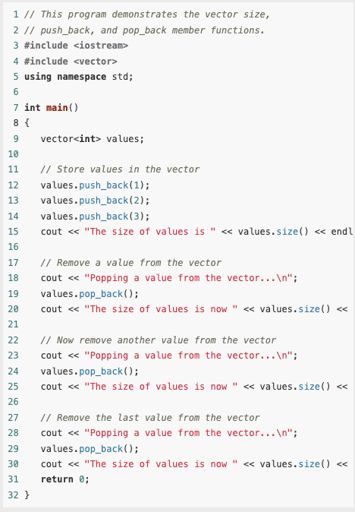
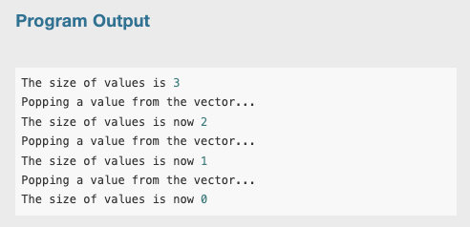
Example

Slide 36
Clearing a Vector
To completely clear the contents of a vector, use the clear member function, as shown in the following example:
numbers.clear();

Slide 37
Detecting an Empty Vector
To determine if a vector is empty, use the empty member function.
The function returns true if the vector is empty, and false if the vector has elements stored in it.
Assuming numberVector is a vector, here is an example of its use:
if (numberVector.empty())
cout << "No values in numberVector.\n";

Slide 38
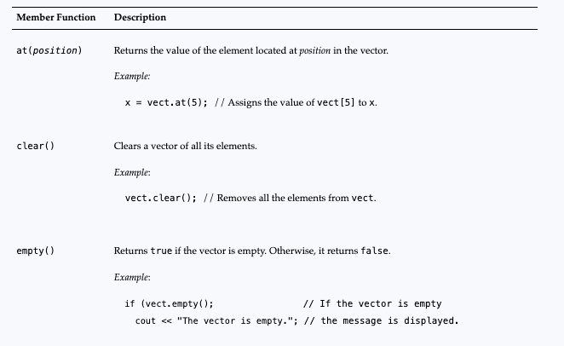
Common Vector Member Functions

Slide 39
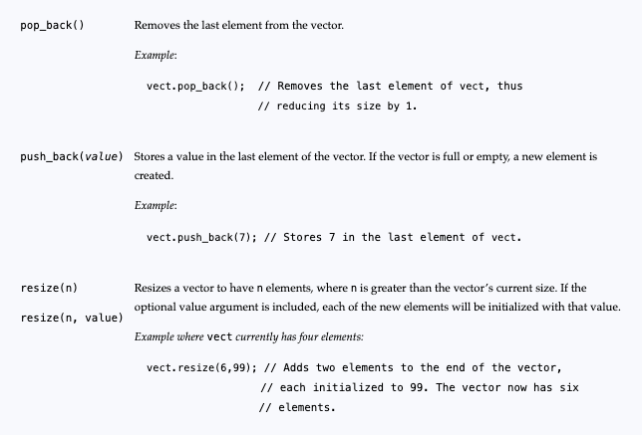
Common Vector Member Functions

Slide 40
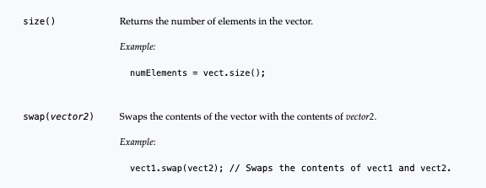
Common Vector Member Functions

